Slide 1
MIDI
By: Nicolás Salcedo, Juan Pablo Saenz & José María Trujillo
8ºB

Slide 2
Index
MIDI´s meaning
MIDI´s characteristics
MIDI´s history
MIDI´s applications
MIDI´s devices
MIDI´s types
MIDI´s Technical specifications
MIDI´s extensions
MIDI´s hardware alternatives
MIDI’ s versions

Slide 3
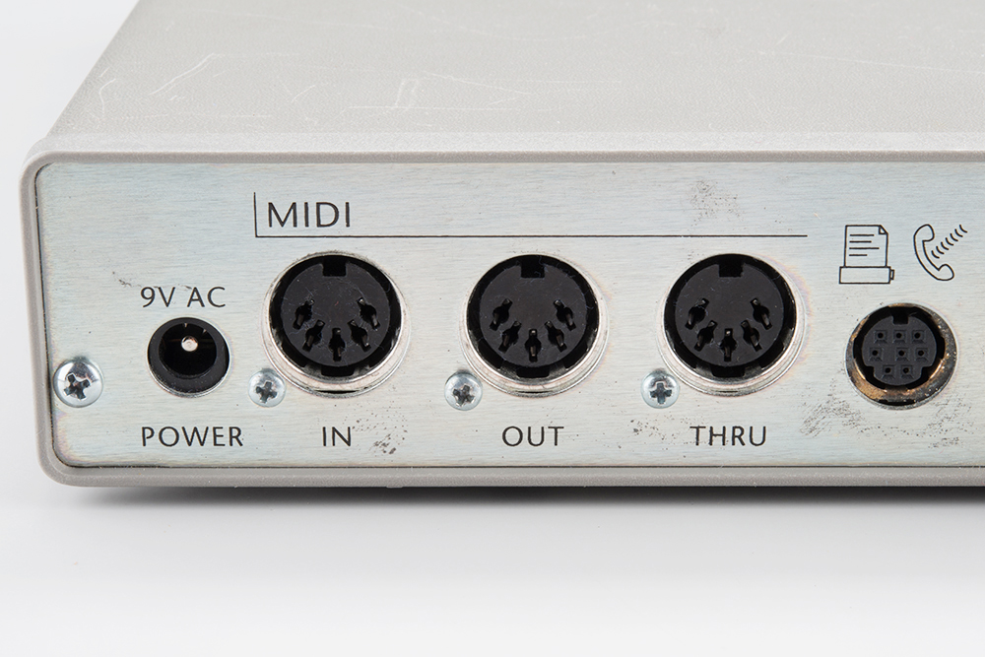
MIDI’ s meaning
MIDI stands for Musical Instrument Digital Interface.
It is basically a technological standard that lets that many musical instruments could be played at the same time.
A MIDI connection can transmit until 16 information channels that could be connected to different devices.
The MIDI system consists on taking different types of messages taking account its musical notation, tone and speed.

Slide 4
MIDI´s characteristics
MIDI is a digital interference for music equipment.
MIDI is not a musical instrument.
MIDI represent, record and play the pattern of music playing, it does not record sound of the music.

Slide 5
MIDI´s History
It all began in June 1981 with its creator Ikutaro Kakehashi, he proposed a idea of an interface for universal sensitizers.
However this idea developed and in 1982 Robert Moog presented MIDI to all the public.
The protocol 1.0 was published in August 1983, then in 2013 Ikutaro Kakehashi and Dave Smith received the technical Grammy, for developing the MIDI.

Slide 6
MIDI´s Applications
MIDI´s main application was to communicate different musical instruments, this creates that when a musical note is played the signal can be used to play the same note in another instrument.
Another application is for composition as it could be used to edit the song that is being worked.
Finally it could also be used in computers for moving and guarding MIDI files, it could also be used for the exchange of files, to interact with the software of the computers and to make soundtracks for the videogames.

Slide 7
MIDI´s devices
One of MIDI´s devices is its connectors, which are used to transmit the signal to the amplifiers or other objects, it could also be used to combine the multiple devices in the room, and it can synchronize the MIDI device to a computer.
Another MIDI device are its controllers, there are two types of MIDI controllers, one of them is used for performance to control the instruments. The second one is used for creating music.

Slide 8
MIDI´s types
Nektar Panorama P4
Akai Pro MPK249
Livid Instruments BASE II
Novation Launchpad Pro
Native Instruments Komplete Kontrol Series
Ableton Push

Slide 9
MIDI´s devices
Another device is the MIDI instrument that is used to send and receive signals from other MIDI´s.
Another device is the synthesizers that are used to create different types of sounds.
Another device is the sampler, that is used to record and digitalize the audio to store it in a memory.
Another device is the drum machine, that is used to reproduce sounds of drums and percussion.
Finally the last device is a device of effects that are used onstage for special sound effects like delay and chorus.

Slide 10
MIDI´s technical specifications
First of all general MIDI has a total of 128 instruments to interact with.
A MIDI message is an instruction that controls the aspect of the receiver device.
The messages system exclusive are the reason of the flexibility of the standard MIDI.
Finally the devices normally do not respond to any type of message defined in the MIDI specification.

Slide 11
MIDI´s extensions
One of MIDI´s extensions is the general MIDI, which permits the selections of sounds of a instrument.
Another of MIDI´s extensions is the MIDI´s tuning standard which is used for micro affinitions.
Another of MIDI´s extension is the MIDI´s time code, that is used to control the system MIDI with its internal watch.
Another of MIDI´s extension is the MIDI´s machine control, which is used for a series of commandos of system exclusive.
Another of MIDI´s extension is MIDI´s timestamping, which is a solver for synchronization problems.
Another of MIDI´s extension is MIDI´s sample dump standard which is used for the transport of samples between instruments.
Finally another MIDI´s extension is the downloadable sounds that lets download sounds.

Slide 12
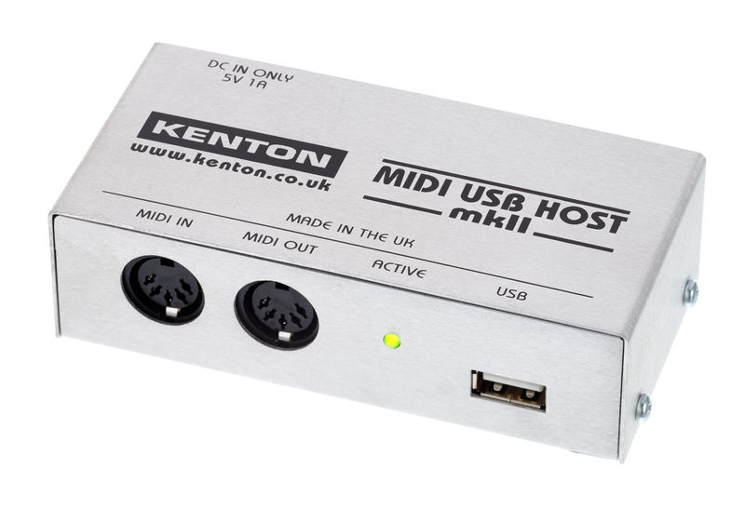
MIDI´s hardware alternatives
One of MIDI´s hardware alternatives is the USB and fire wire that is the main hardware that is used for MIDI.
Other of MIDI´s hardware alternatives are the XLR connectors and the joystick port MIDI, this are used for connecting MIDI to the computer.
Other of MIDI´s hardware alternatives is the mLAN that is used for the local area.
Other of MIDI´s hardware alternatives is the Ethernet that is used for the new connections of the computers.
Other of MIDI´s hardware alternatives is the OSC that is used as a support for the hardware and software.
Finally another of MIDI´s hardware alternatives is the wireless MIDI, that is transmitted by Wi-Fi and Bluetooth and is used mainly in iOS.

Slide 13
MIDI´s versions
One of MIDI´s version is the protocol HD that offers a compatibility with MIDI 1.0 and it is created for supporting great speeds and permit the detection of other devices.
Other of MIDI´s version is the UDP that is a review of the protocol HD.
Finally the other of MIDI´s version is the HDWG that is the same as the protocol HD but it includes the representation of different companies, and it has compressed audio.

Slide 14
References
http://www.grammy.com/news/technical-grammy-award-ikutaro-kakehashi-and-dave-smith
https://whatis.techtarget.com/definition/MIDI-Musical-Instrument-Digital-Interface
https://makingmusicmag.com/what-exactly-is-midi/

Slide 15
End of the Presentation
Thanks for listening

