Slide 1
Path of absence
By: Juan Pablo Saenz 9ºB

Slide 2
Reference 1: Doris Salcedo(Conceptual reference)
The first reference that I will use is Doris Salcedo, especially the artwork in which she used Roses to guide de path from Jaime Garzon´s house, to the place he was killed. This is an installation, that includes body and space, because in makes the people follow the line of roses. The only material used for this artwork, were roses. The concept that it is presenting, as mentioned before, is the murder of Jaime Garzon.

Slide 3
Reference 2: Chiharu Shiota(aesthetic reference)
The second reference I will use is Chiharu Shiota, she is a Japanese artist, that specializes on the use of wool. All her pieces are installations, this because she specializes on this art form. Her installations consist on using wool, to convert places into sorts of different environments, in which people can interact with. Her artworks don’t have any special concepts, just the transformation of different places, into whole different environments.

Slide 4
Reference 3: Pablo Lehmann(Aesthetic reference)
The third and last reference I'm going to use, is Pablo Lehmann, especially I will focus on this artwork, Pablo Lehmann is an artist that specializes on an art technique called paper art. This art technique consist on transforming normal paper into art pieces, like on the example of the left, that is a shirt with text, made out of paper. As Chiharu Shiota, Pablo Lehmann does not have any special concept.

Slide 5
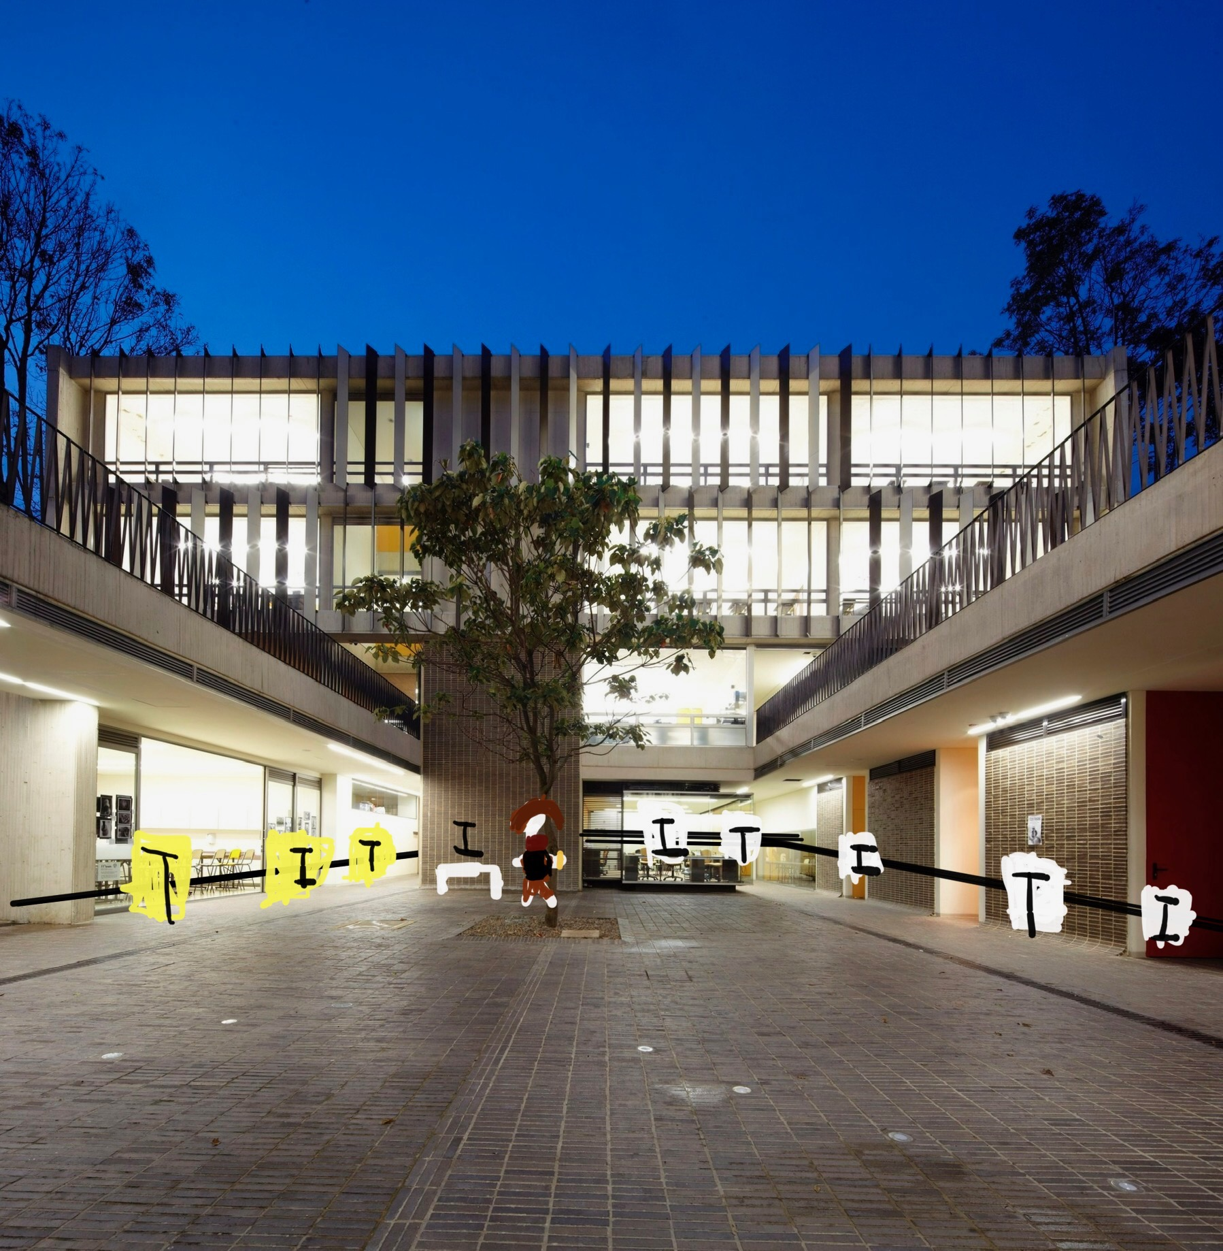
Sketch/Curatorial sketch
Reference card:
Name: Juan Pablo Saenz
Title of the artwork: Path of absence
Text/ instructions: For people to interact with my artwork, they would need to follow the path as indicated, and read the different texts, that will be all over the path, they will have to follow the instructions written on the text, so they can relate to the absence and loss of someone. The Texts will be joined with different images, that will people relate more easily with my artwork, and the main concept I want to show.

Slide 6
Sketch/curatiorial

Slide 7
Sketch/Curatorial sketch
Concept of the artwork: The main concept I would like to work with is absence (Specifically the absence of someone).
Aesthetic elements/connections with the references: First of all, I will use wool, as my second reference Chiharu Shiota, that specializes on wool artwork. And for the mannequin concept, I will relate to the artwork shown of my third reference Pablo Lehmann. Because the mannequin will show the emptiness of a person, because it will only carry clothing's that represent that person, and Pablo Lehmann shirt, is not worn by anyone, showing the absence of a person to. Finally, my first reference Doris Salcedo is represented by the path made by black wool, it represent loss and absence, because of the color of the wool, and the pictures and text included on the path.

